Slide 1

KALERWE
S.D.A Hymnal 83
5 ~ Verses
5.
Ka Tumusinze Mukama Waffe…
~
O Worship The King…

Slide 2

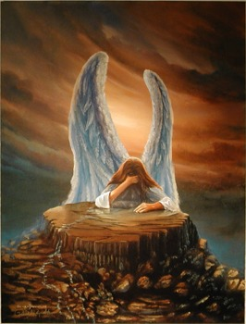
1 of 5 verses
Ka tumusinze Mukama waffe,
Katuyimbe ku kwaga-l(a) okungi
Oyo yekka kye kiddukiro kyaffe,
Ekitiibwa kyonna kimwe-toloola.

Slide 3
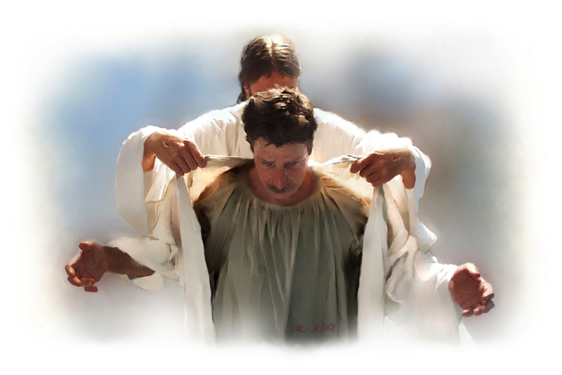
2 of 5 verses
Tuyimbe ku kisa kye ekingi,
(E)Byambalo bye gwe (o)musa-na gw’ensi;
Okubwatuka kwe kutiisa byonna,
Amakubo ge gali ne- mu mpewo.

Slide 4
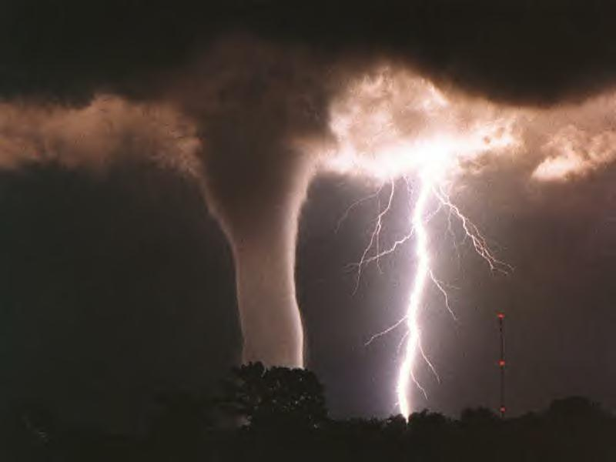
3 of 5 verses
Obuyinza bwe era n’entiisa,
Birabikira wonna ku bire;
Eggulu n’eraddu n’omuyag(a) era,
Byonna baddu be abamu-wereza.

Slide 5
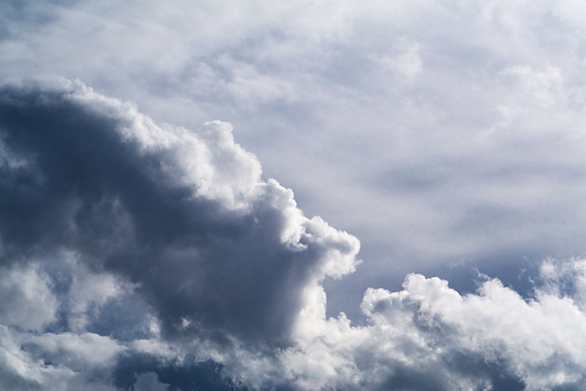
4 of 5 verses
Wansi w’eggulu (O)mugulumizu,
Wateekebwa dda
Enku-luze yo;
Ye nsi gye watonda n’ogyetolooza,
Ennyanja zonna
nga en-salo zaayo.

Slide 6

5 of 5 verses
Ani ayinza okunyumiza,
Ebyo, (O)mugabi waffe,- by’ogaba?
Eby’ekisa kyo, by’ebitwewunyisa;
Katonda, (O)mulokoz(i),
Era- Kabaka!

